Slide 1

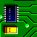
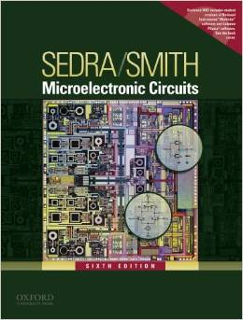

International University
School of Electrical Engineering
ANALOG ELECTRONICS
Lecture # 6: Output Stages and Power Amplifiers
Text book:
Sedra and Smith, “Microelectronic Circuits,” 6th Edition.
Link: Blackboard to download materials

Slide 2
Chapter Outline
1. Classification of Output Stages
2. Class A Output Stage
3. Class B Output Stage
4. Class AB Output Stage
5. Biasing the Class AB Circuit
6. CMOS Class AB Output Stages

Slide 3
Introduction
IN THIS CHAPTER YOU WILL LEARN
The classification of amplifier output stages on the basis of the fraction of the cycle of an input sine wave during which the transistor conducts.
Analysis and design of a variety of output-stage types ranging from the simple but power-inefficient emitter follower class (class A) to the popular push-pull class AB circuit in both bipolar and CMOS technologies.
Thermal considerations in the design and fabrication of high-output power circuits.

Slide 4
Introduction
One important aspect of an amplifier is output resistance.
This affects its ability to deliver a load without loss of gain (or significant loss).
Large signals are of interest and small-signal models cannot be applied.
Total harmonic distortion (THD) is good measure of linearity of output stage.
Most challenging aspect of output stage design is efficiency.
Power dissipation is highly correlated to internal junction temperature.

Slide 5
Power Amplifiers, Power FETS & BJTs
Audio (stereo)
MP3 Players
Motor controllers
Servo controllers (robotics)
Drivers for transducers
Sonar (sound navigation and ranging)
Buzzers
Laser diodes (CDs, DVDs)
Considerations
Low output resistance (to deliver power)
Low total harmonic distortion
Power dissipation by output transistors

Slide 6
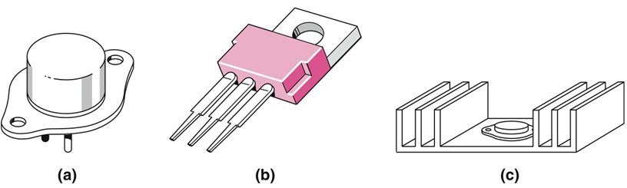
Packaging Schemes
Can/tab is normally the collector (BJT)
Heat sink
E & B (BJT)
One of these may also
be collector (BJT)
TO-3

Slide 7
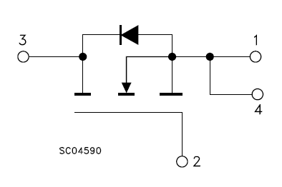
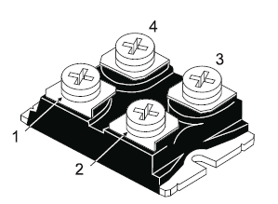
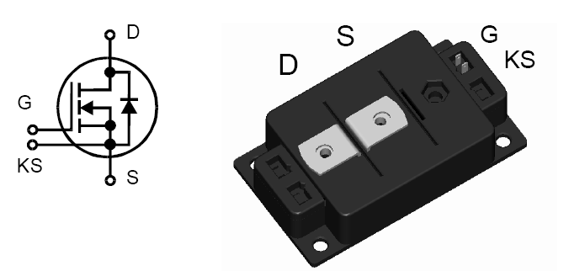
Packaging Schemes
200 A, 100 V, 4.5 mΩ FET
580 A, 200 V, 3.5 mΩ FET

Slide 8
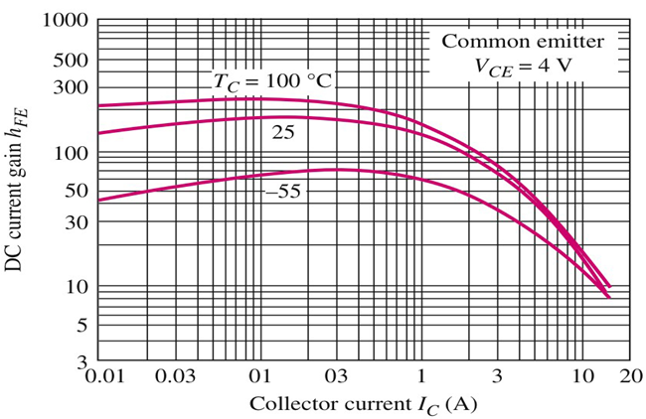
Typical DC β for 2N3055 (Power BJT)
Note that at 10 A, β drops to 10!
β increases “gets better” with increasing temp
β decreases (significantly) with increasing IC

Slide 9
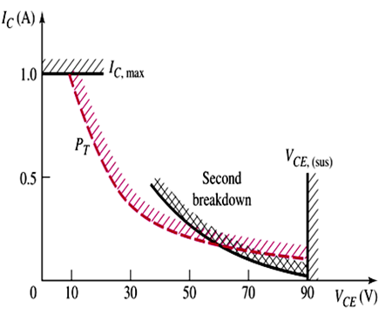
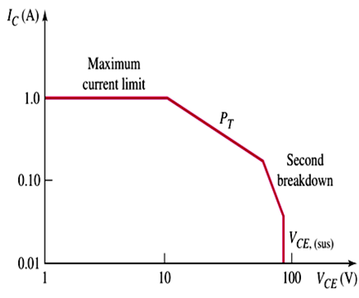
Safe Operating Area (SOA) for BJT
Max I, determined by, for
example, how much current
bonding wires can handle
Max V normally determined by avalanche
breakdown of reverse biased CB junction.
Linear scale
Log scale
Max P_{T}, hyperbola
SOA
Slight non-uniformities in semiconductor material causes non-uniformities in current density. This produces regions of increased heating, which lowers the resistance of semiconductor, which increases current, which generates more heat,... This can cause material to melt. This is called second breakdown.

Slide 10
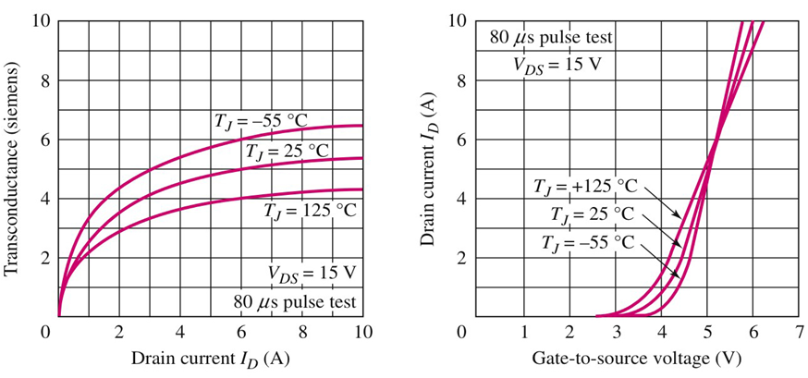
Typical High-Power MOSFET Characteristics
g_{m} decreases with increasing temperature
But, variation in g_{m} is less than variation in β
Power MOSFETs – no second breakdown
Faster switching times

Slide 11
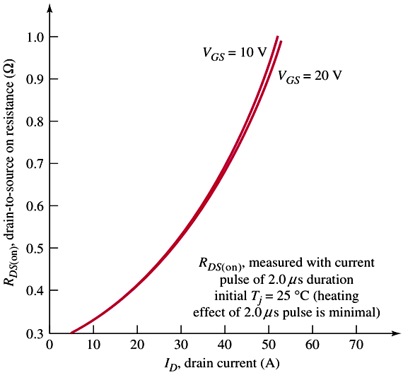
Drain-to-Source Resistance Versus I_{D}
Some MOSFETSs have
R_{DS(ON)} in milliohm range
At I_{D} = 30 A, V_{DS} > 15 V
P_{D} = 30 ×15 = 450 W
Note the large currents

Slide 12
Comparing Power BJTs and MOSFETS
BJT
+ Large base current
I_{C} = 10 A, β = 10,
needs I_{B} = 1 A
+ Second breakdown
+ Thermal runaway
MOSFET
+ No gate current, can be driven by standard logic circuit
+ No second breakdown
+ No thermal runaway
MOSFETs are rapidly replacing power BJTs

Slide 13
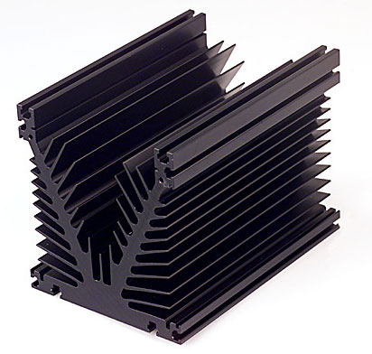
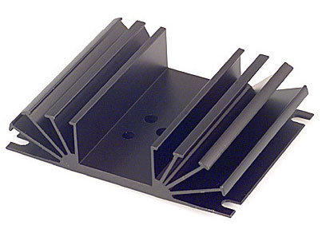
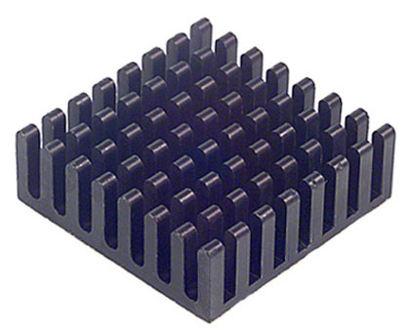
Some Heat Sinks
θ = 1 ºC/W
θ = 0.1 ºC/W
Thermal resistance
θ = 10 ºC/W

Slide 14
Output Stage Functions
Provide amplifier with low output resistance
Handle large signals with low THD (Total Harmonic Distortion)
Deliver power to the load efficiently
Output stages are classified according to the i_{C} waveform that results when an input signal v_{I} is applied.
Classification of Power Amplifier
Power amplifiers are classified according to the collector current waveform that results when an input signal is applied.
Conducting angle.
Notes:
THD = Total Harmonic Distortion

Slide 15
CLASSIFICATIONS OF OUTPUT STAGES
Output Stages
Class A output stage:
Bias current is greater than the magnitude of the signal current
Conduction angle is 360°
Class B output stage:
Biased at zero dc current
Conduction angle is 180°
Another transistor conducts during the alternate half-cycle
Class AB output stage:
An intermediate class between A & B
Biased at a nonzero dc current much smaller than the peak current of the signal
Conduction angle is greater than 180° but much smaller than 360°
Two transistors are used and currents are combined at the load
Class C output stage:
Conduction angle is smaller than 180°
The current is passed through a parallel LC network to obtain the output signal
Class A, B and AB are used as output stage of op amps
Class AB amplifiers are preferred for audio power amplifier
Class C amplifiers are usually used at higher frequencies

Slide 16
Amplifier Efficiency η
A figure of merit for the power amplifier is its efficiency, η .
Efficiency ( η) of an amplifier is defined as the ratio of ac output power (power delivered to load) to dc input power .
By formula :
As we will see, certain amplifier configurations have much higher efficiency ratings than others.
This is primary consideration when deciding which type of power amplifier to use for a specific application.
⇒ Amplifier Classifications
η = P_{AC} / P_{DC}

Slide 17
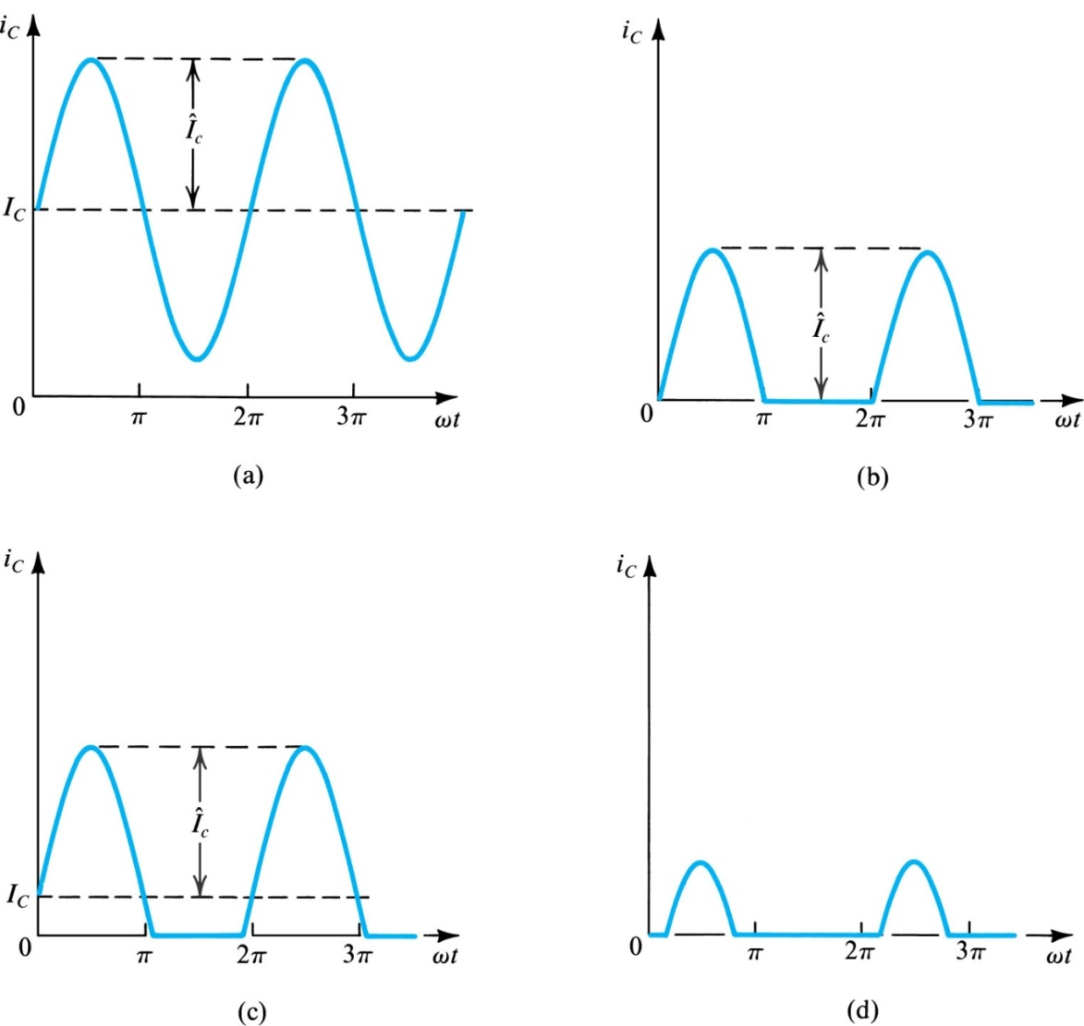
11.1. Classification of Output Stages
Figure 11.1: Collector current waveforms for transistors operating in (a) class A, (b) class B, (c) class AB, and (d) class C amplifier stages.
(always on)
Output stages are classified according to collector current waveform that results when input signal is applied.
They are outlined in Figure 11.1.
The classification also applies for output stages with MOSFETs
(on during one half cycle)
(hybrid)
(on less than one half cycle)

Slide 18
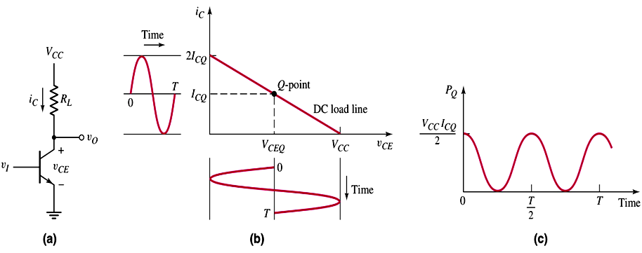
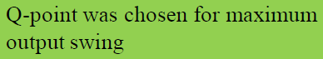
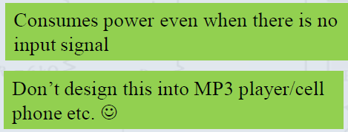
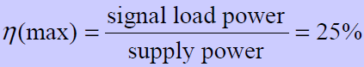
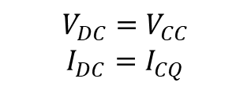
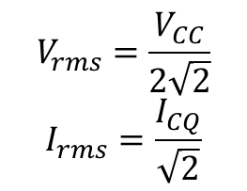
11.2. Class A Output Stage
CE Amplifier is not proper for using as a power amplifier
$$V_{rms}=\frac{V_{CC}}{2\sqrt{2}}$$
$$I_{rms}=\frac{I_{CQ}}{\sqrt{2}}$$
$$V_{DC}=V_{CC}$$
$$I_{DC}=I_{CQ}$$

Slide 19
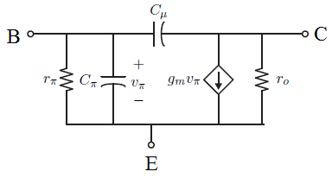
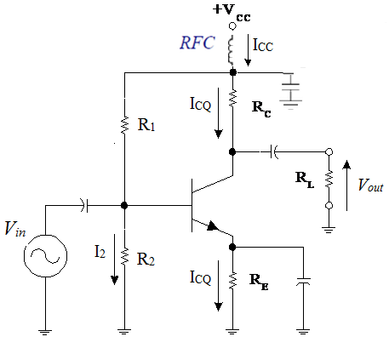
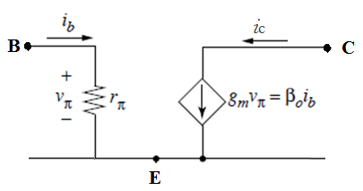
Class A Amplifier Analysis
AC analysis
AC signal model of BJT
Supposing that Cμ, Cπ
are negligible
DC block: Zc=1/ωC is large
=> Zc =0(Ω) at AC mode.

Slide 20
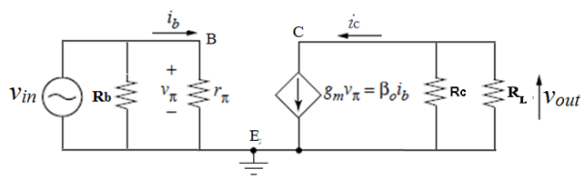
Class A Amplifier Analysis
AC analysis
Here
If Vin =A.sin(ωt) then
Small signal model

Slide 21
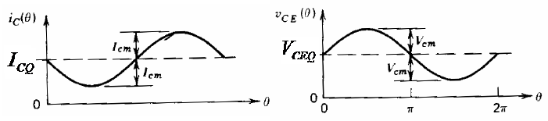
Class A Amplifier Analysis
By superposition , total collector current is :
By superposition , total collector voltage is :
DC component is created by the DC biasing circuit.
AC component is created by small signal v_{C}
The total current at collector : i_{C_Total}
The total voltage at collector : v_{CE_Total}

Slide 22
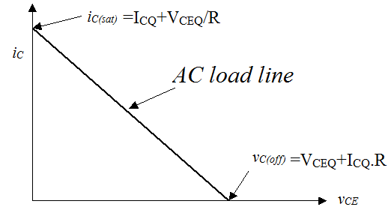
AC load line
We know that
But

Slide 23
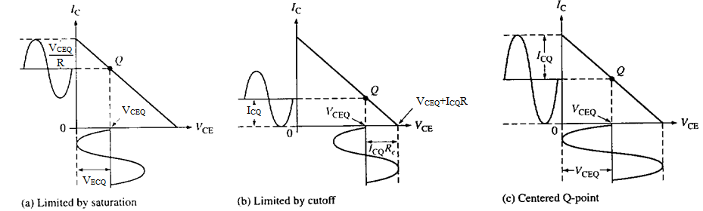
DC Biasing + AC signal
When an ac signal is applied to the base of the transistor, I_{C} and V_{CE} will both vary around their Q-point values.
When the Q-point is centered, I_{C} and V_{CE} can both make the maximum possible transitions above and below their initial dc values.
When the Q-point is above the center on the load line, the input signal may cause the transistor to saturate. When this happens, a part of the output signal will be clipped off.
When the Q-point is below midpoint on the load line, the input signal may cause the transistor to cutoff. This can also cause a portion of the output signal to be clipped.

Slide 24
Power Calculation
The total DC power
The total DC power, P_{i}(DC) , that an amplifier draws from the power supply :
When the Q-point is centered:

Slide 25
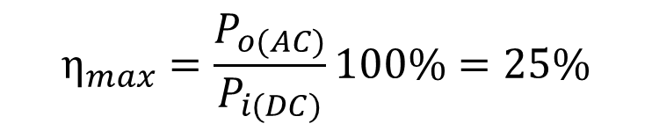
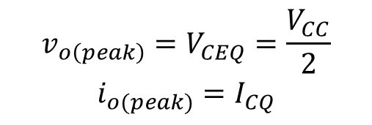
Power Efficiency ( η)
$$v_{o\left(peak\right)}=V_{CEQ}=\frac{V_{CC}}{2}$$
$$i_{o(peak)}=I_{CQ}$$
4
$$η_{max}=\frac{P_{o(AC)}}{P_{i(DC)}}100\%=25\%$$

Slide 26
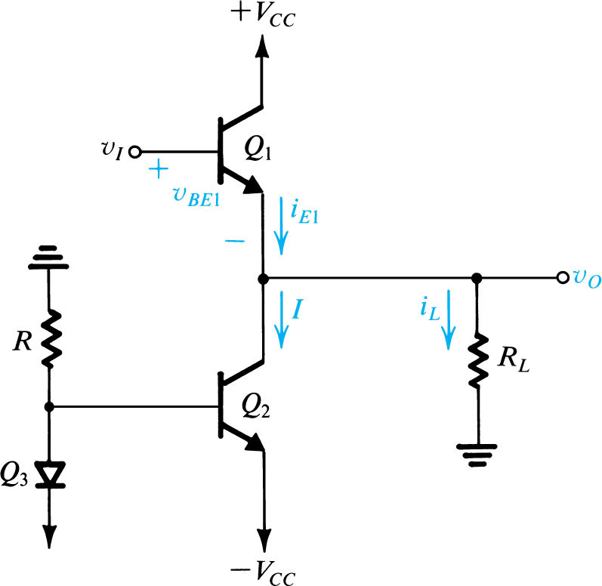
11.2. Class A Output Stage
Figure 11.2 An emitter follower (Q₁)
biased with a constant current I supplied by transistor Q₂.

Slide 27
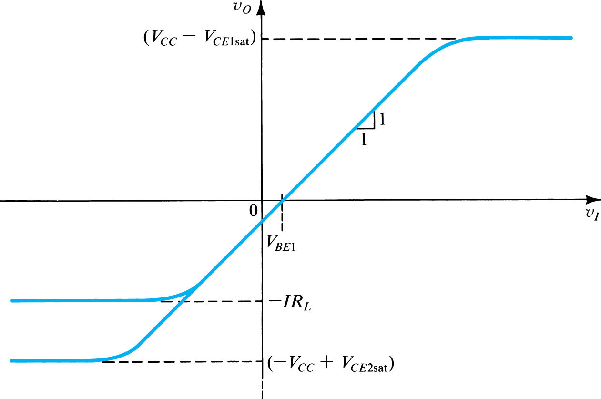
Figure 14.3 Transfer characteristic of the emitter follower. This linear characteristic is obtained by neglecting the change in v_{BE1} with i_{L}. The maximum positive output is determined by the saturation of Q₁. In the negative direction, the limit of the linear region is determined either by Q₁ turning off or by Q₂ saturating, depending on the values of I and R_{L}.

Slide 28
11.2.3. Power Dissipation
Maximum instantaneous power dissipation in Q₁ is V_{CC}I.
It is equal to power dissipation in Q₁ with no signal applied (quiescent power dissipation).
Emitter-follower transistor dissipates the largest amount of power when v_{O} = 0.
Since this condition (no input signal) may be maintained or long periods of time, transistor Q₁ must be able to withstand a continuous power dissipation of V_{CC}I.

Slide 29
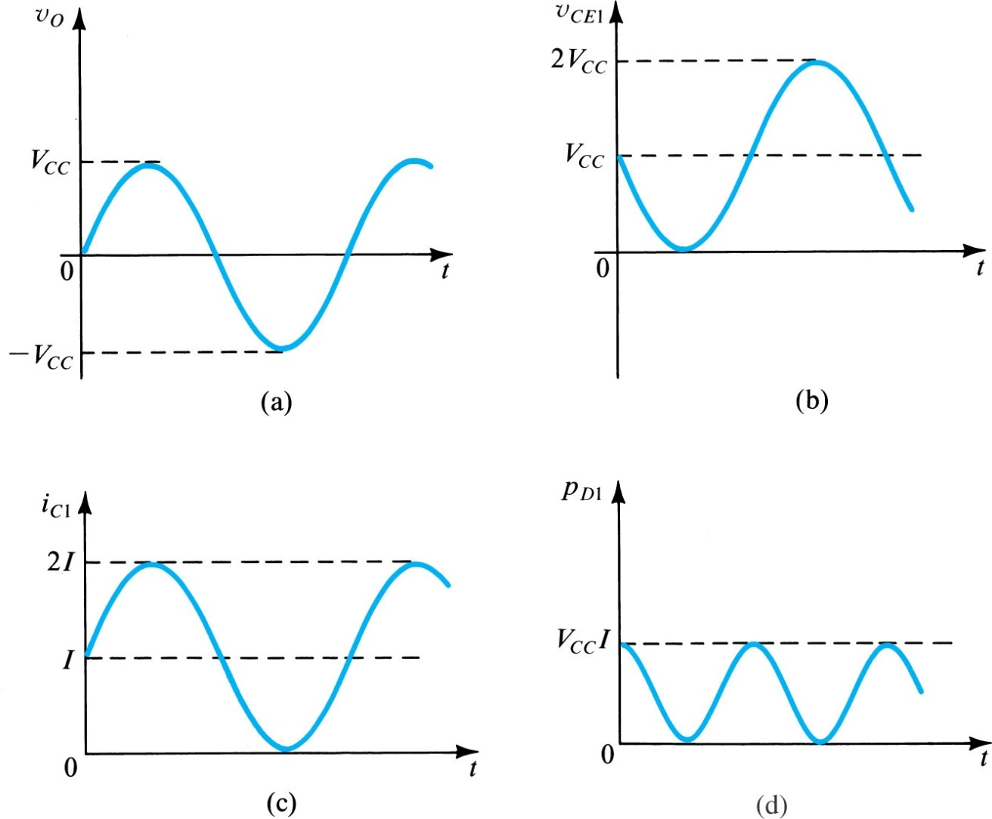
Figure 11.4: Maximum signal waveforms in the class A output stage of Fig. 11.2 under the condition I = V_{CC} /R_{L} or, equivalently, R_{L} = V_{CC}/I. Note that the transistor saturation voltages have been neglected.

Slide 30
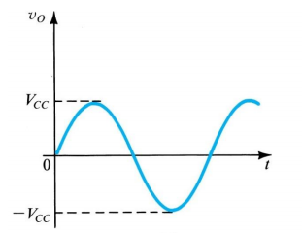
11.2.4. Power Conversion Efficiency
Efficiency
Peak value of output voltage

Slide 31
Quick Summary
Basic BJT output stage circuit is the Emitter follower.
2. Class A amplifier(1 BJT):
Characteristic performance: Conducts over entire v_{i} cycle.
Advantage: Low THD except when signal amplitude is large.
Disadvantage: Conducts current and dissipates power when v_{i} = 0.
3. The class A amplifier provides the most “nearly linear”
amplification of its input up to near VTC saturation, but this comes
at a price: The maximum power conversion efficiency that can be
obtained is 25%.
4. That is 75% of the power supplied by the sources is dissipated
in the transistors. This is a waste of power, and could lead to
a serious heating issue with the transistors.
All of this constant battery power is dissipated in the transistors
even when no signal is applied – zero percent efficiency!
Notes:
THD = Total Harmonic Distortion

Slide 32
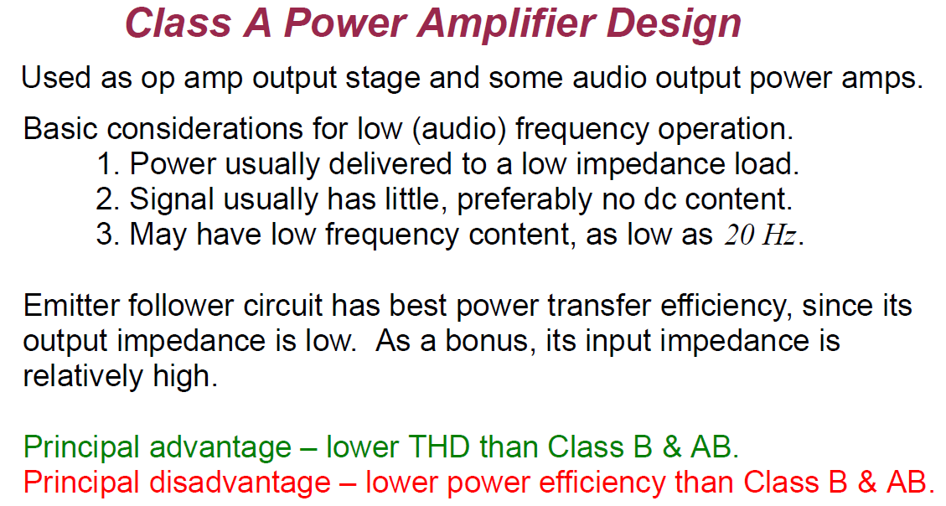

Slide 33
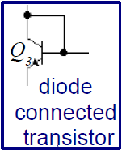
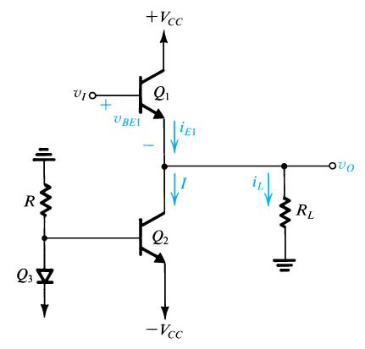
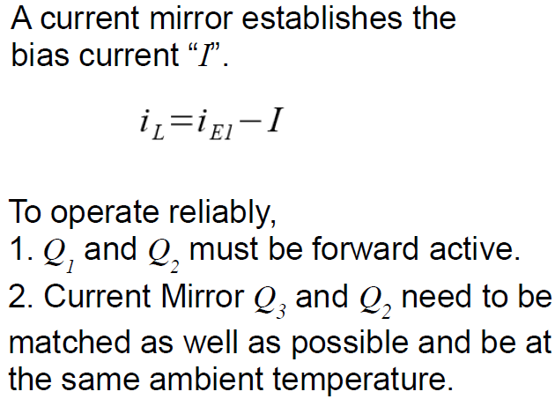
Current Biased Class A Emitter Follower
current mirror

Slide 34
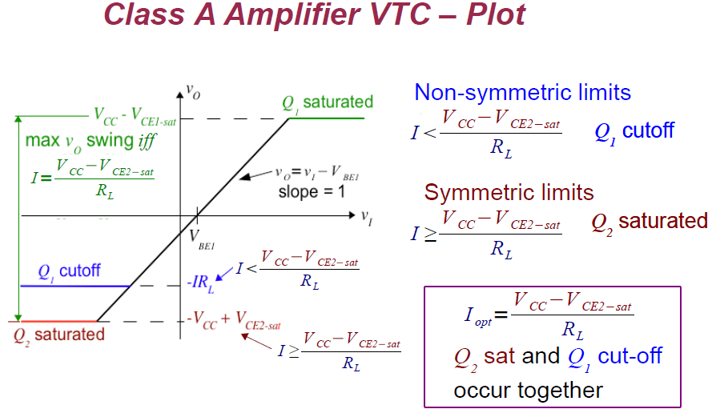

Slide 35
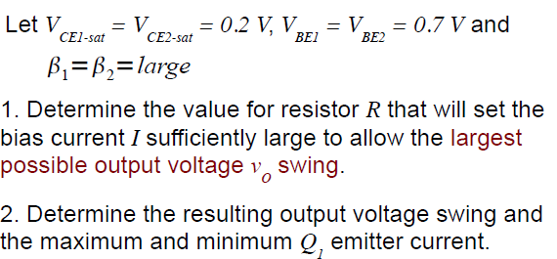
+V_{CC} = +15 V
Example
-V_{CC} = -15 V

Slide 36
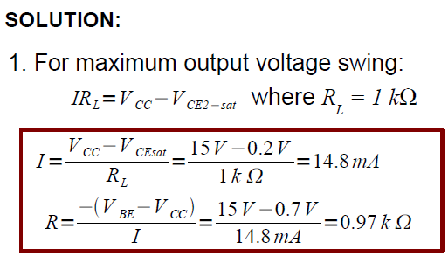
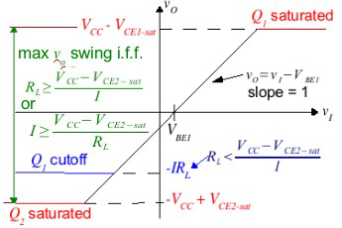
=1kΩ

Slide 37
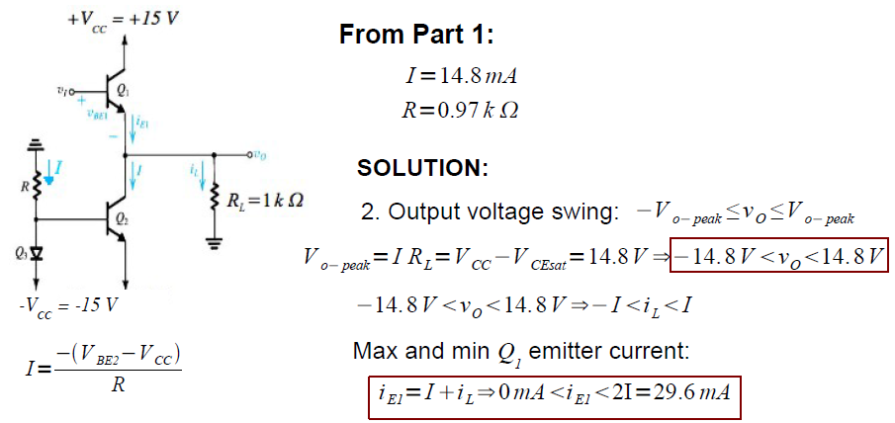

Slide 38
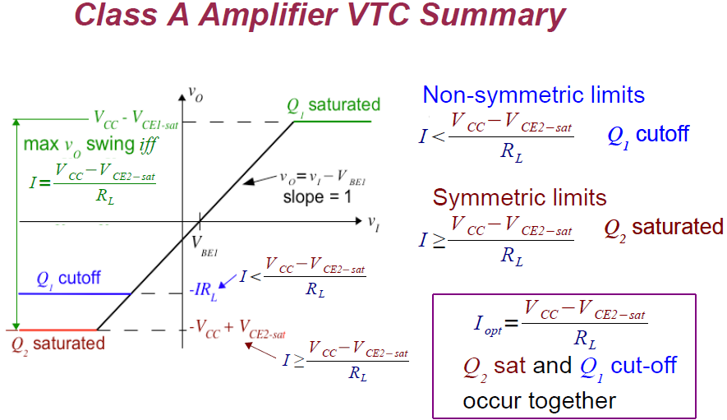

Slide 39
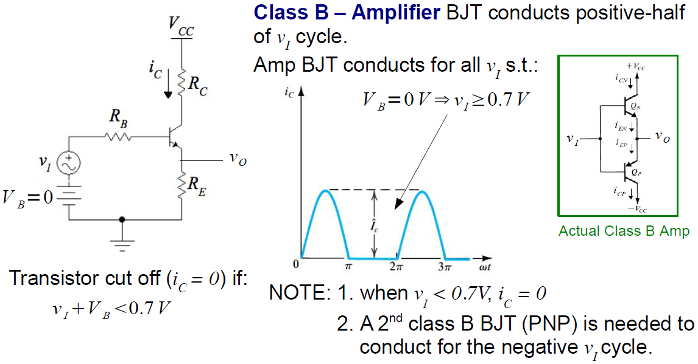
11.3. Class B Output Stage

Slide 40
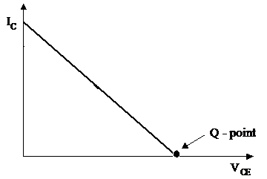
11.3. Class B Amplifier
Class-B amplifier provides an output signal varying over one-half the input signal cycle
Where is the Q-point on the load line ?
DC analysis: Since there is no DC voltage at port B of transistor =>The dc bias point for class-B amplifier is therefore at 0 volt.
The advantage of a class-B amplifier is that the collector current is zero when the input signal to the amplifier is zero.
Therefore the transistor dissipate no power in the quiescent condition.

Slide 41
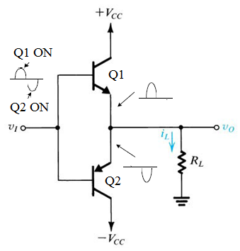
11.3. Push-pull amplifier (Class B)
Obviously, the output is not a sine wave if only one half-cycle is present.
Therefore, a two-transistor configuration, is necessary to get a sufficiently good reproduction of the input waveform.
This amplifier configuration is known as push-pull emitter follower (push-pull amplifier) or complementary-symmetry amplifier.

Slide 42
11.3. Push-pull amplifier (Class B)
Positive Input : For vi > 0.7 V, Q1 = ON, Q2 = OFF.
During the positive half-cycle of the input signal, Q1 conducts, and conduction results through the transistor R_{L} .
During this time, Q2 is still off.
→ provide output on the positive-output half-cycle.
Negative Input: For vi < -0.7 V, Q1 = OFF, Q2 = ON.
During the negative half-cycle of the input signal, Q1 is off, and Q2 is conducts.
As a result, conduction of Q2 start to built while Q1 remains off.
→ provide output on the negative-output half-cycle.
No Input: -0.7 V < vi < 0.7 V
When the transistor is in its quiescent state (no input), both transistors are biased at cutoff.

Slide 43
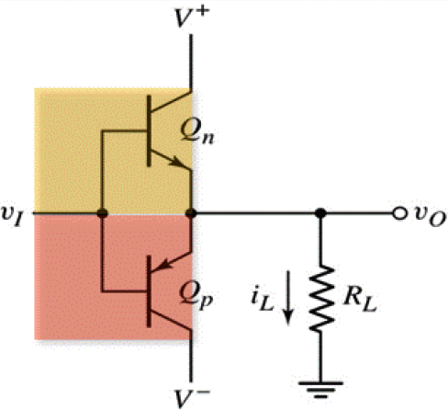
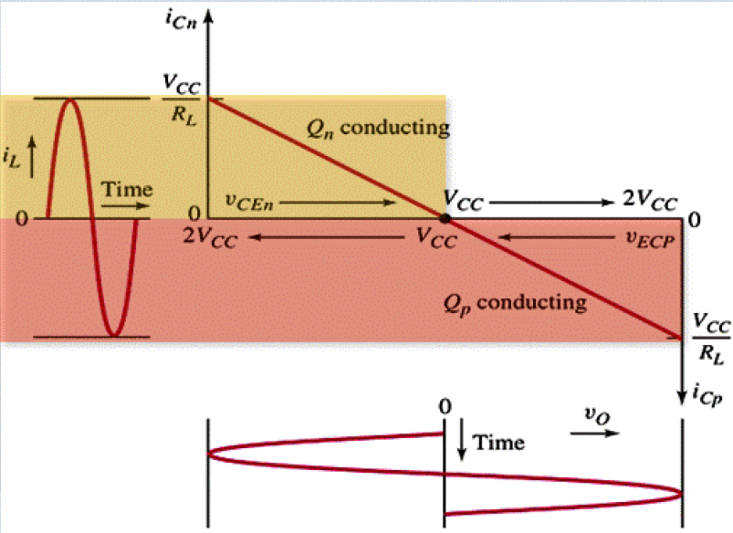
11.3. Class B Output Stage
Effective Load Line:
Ideal Class-B Output Stage

Slide 44
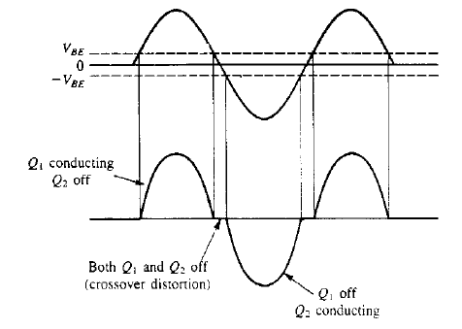

11.3.2 Class B Output Stage
Crossover distortion
Because of the biasing arrangement, class-B amplifiers are subject to a type of distortion.
The resulting distortion in the output waveform is quite common and is called crossover distortion.
To prevent crossover distortion, both transistors will normally be biased at a level that is slightly above cutoff.
Biasing both transistors slightly above cut-off will allow the amplifier to provide a linear output that contains no distortion.

Slide 45

11.3.2 Power –Calculations
DC Input Power
The total (DC) input power comes from the V_{CC} source :
The total current drawn from the supply is the sum of the average Q1 collector current and the current through the amplifier base circuit. The average value of the current through the collector of Q1 is given as:

Slide 46

11.3.3 Power –Calculations
Maximum AC Output Power
Maximum amplifier efficiency, η

Slide 47


Slide 48


Slide 49

Solution
1)
2)

Slide 50




Solution
3)
Since each supply provides a current waveform of half-sinusoids, the average current drawn from each supply will be
Thus the average power drawn from each supply is
4)
for a total supply power of 32.8 W. The power-conversion efficiency is
The maximum power dissipated in each transistor
${(V}_{CE(ave)}=\frac{V_{CC}}{π}$, $I_{C(ave)}=\frac{V_{CC}}{πR_{L}})$

Slide 51
Quick Summary
Class B amplifier (2 BJTs):
Characteristic performance: Conducts over 1/2 v_{i} cycle (each BJT).
Advantage: No power dissipated when v_{i} = 0.
Disadvantage: High THD even when signal amplitude is small.

Slide 52



A

Slide 53

11.4. Class AB Output Stage
Class AB Operation
(set by V_{B})

Slide 54


Basic Class AB Amplifier Operation
Supply bias voltages so that
both transistors are turned
on, with small quiescent current
1. Bias Q_{N} & Q_{P} into slight conduction (fwd. act.)
when v_{I} = 0: i_{N} = i_{P}.
2 Ideally Q_{N} & Q_{P} are:
Matched (unlikely with discrete transistors and challenging in IC).
i_{N} = i_{P} = I_{Q} = I_{S}exp(V_{BB} ⁄ 2V_{T})
b. Operate at same ambient temperature.
V_{BB}
3.For v_{i} > 0: i_{N} > i_{P} i.e. Q_{N} most cond. (like Class B).
4.For v_{i} < 0: i_{P} > i_{N} i.e. QP most cond. (like Class B).
Notes:
I_{Q} : quiescent current
conclude that the class AB stage operates in much the same manner as the class B
circuit, with one important exception: For small v_{I}, both transistors conduct, and as v_{I} i_{s} increased or decreased, one of the two transistors takes over the operation.

Slide 55


Characteristics of Class-AB Output Stage

Slide 56


MOSFET Class-AB Output Stage
Supply bias voltages so that
both FETs are turned on, with
small quiescent current

Slide 57

11.4. Class AB Output Stage
Crossover distortion can be virtually eliminated by biasing the complementary output transistor with small nonzero current.
A bias voltage V_{BB} is applied between Q_{N} and Q_{P}.

Slide 58

Class AB VTC Plot
Ideally the two DC base
voltage sources are
matched and V_{BB}/2 ≈ 0.7V
Ideally, zero cross-over
distortion
Figure 11.12: Transfer characteristic of the class AB stage in Fig. 11.11.

Slide 59

11.4.2. Output Resistance
Figure 11.13: Determining the small-signal output resistance of the class AB circuit of Fig. 11.11.
Read Example 11.3

Slide 60

11.5. Biasing the Class AB Circuit
Figure 11.14 shows class AB circuit with bias voltage V_{BB}.
Constant current I_{BIAS} is passed through pair of diodes D₁ and D₂.
In circuits that supply large amounts of power, the output transistors are large-geometry devices.
Biasing diodes, however, need not be large.
The diode biasing has an
Important advantage:
Thermal stabilization of
Quiescent current
Figure 11.14: A class AB output stage utilizing diodes for biasing. If the junction area of the output devices, Q_{N} and Q_{P}, is n-times that of the biasing devices D₁ and D₂, a quiescent current I_{Q} = nI_{BIAS} flows in the output devices.

Slide 61

11.5.2. Biasing Using the V_{BE} Multiplier
Figure 11.15 A class AB output stage utilizing a V_{BE} multiplier for biasing
Circuit simply multiplies V_{BE1} by the factor (1+ R₂/R₁)
Notes:
The multiplication factor is obviously under the designer’s control and can be
used to establish the value of V_{BB} required to yield a desired quiescent current I_{Q}.

Slide 62

In IC design it is relatively easy to control accurately the ratio of two resistances. In discrete circuit
design, a potentiometer can be used, as shown in Fig. 11.16, and is manually set to produce the desired value of I_{Q}.
Figure 11.16: A discrete-circuit class AB output stage with a potentiometer used in the V_{BE} multiplier.

Slide 63
Quick Summary
Class AB operation is a compromise mode:
1. Delivering better linearity than class B, with reduced efficiency.
2. Delivering better efficiency than class A, with reduced linearity
Class AB amplifier (2 BJTs):
Characteristic performance: Conducts over >1/2 v_{i} cycle (each BJT).
Advantage: Reduced THD over Class B.
Disadvantage: Increased power dissipation over Class B.
ADVANTAGE:
Class AB operation improves on Class B linearity.
Power conversion efficiency similar to Class B
DISADVANTAGES:
1. Emitter resistors absorb output power.
2. Power dissipation for low signal levels higher than Class B.

Slide 64

11.7. Power BJT’s
11.7.1. Junction Temperature
150^{O}C to 200^{O}C
11.7.2. Thermal Resistance θ_{JA}
(eq11.69) T_{J} – T_{A} = θ_{JA}P_{D}
11.7.3. Power Dissipation Versus Temperature
One must examine power-derating curve.
11.7.4. Transistor Case and Heat Sink
(eq11.72) θ_{JA} = θ_{JC} + θ_{CA}
Figure 11.23 Electrical equivalent circuit of the thermal conduction
process;
Read Example 11.7

Slide 65

Figure 11.25: The popular TO3 package for power transistors. The case is metal with a diameter of about 2.2 cm; the outside dimension of the “seating plane” is about 4 cm. The seating plane has two holes for screws to bolt it to a heat sink. The collector is electrically connected to the case. Therefore an electrically insulating but thermally conducting spacer is used between the transistor case and the “heat sink.”

Slide 66

Figure 11.26: Electrical analog of the thermal conduction process when a heat sink is utilized.

Slide 67
11.7.5. The BJT Safe Operating Area (SOA)
The maximum allowable current I_{CMax}. Exceeding this current on a continuous basis can result in melting the wires that bond the device to the package terminals.
The maximum power dissipation hyperbola. This is the locus of the points for which v_{CE}i_{C} = P_{Dmax} (at T_{C0}). For temperatures T_{C} > T_{C0}, the power derating curves described in Section 11.7.4 should be used to obtain the applicable P_{Dmax} and thus a correspondingly lower hyperbola.

Slide 68
11.7.5. The BJT Safe Operating Area (SOA)
The second-breakdown limit. Second breakdown is a phenomenon that results because current flow across the emitter-base junction is not uniform. Rather, the current density is greatest near the periphery of the junction.
Hot Spots
Thermal Runaway
The collector-to-emitter breakdown voltage (BV_{CEO}).

Slide 69

Figure 11.29: Safe operating area (SOA) of a BJT.

Slide 70
11.7.6. Parameter Values of Power Transistors
At high currents, the exponential i_{C}-v_{BE} relationship exhibits a factor of 2 reduction in the exponent.
β is low, typically 30 to 80 (but can be as low as 5). It is important to note that b has a positive temperature coefficient.
At high currents r_{π} becomes very small (a few ohms) and r_{x} becomes important.
f_{T} is low (a few MHz), C_{μ} is large, C_{π} is even larger.
I_{CBO} is large, BV_{CEO} is typically 50 to 100V.
I_{Cmax} is typically in ampere range, as high as 100A.

Slide 71
11.9. IC Power Amplifiers
High-gain, small-signal amplifier followed by class AB output stage.
Overall negative feedback is already applied.
Output current-driving capability of any general-purpose op-amp may be increased by cascading it with class B or class AB output stage.
Hybrid IC

Slide 72

Figure 11.35: Thermal-shutdown circuit.

Slide 73
Summary
Output stages are classified according to the transistor conduction angle: class A (360^{O}), class AB (slightly more than 180^{O}), class B (180^{O}), and class C (less than 180^{O}).
The most common class A output stage is the emitter-follower. It is biased at a current greater than the peak load current.
The class A output stage dissipates its maximum power under quiescent conditions (v_{O} = 0). It achieves a maximum power conversion efficiency of 25%,

Slide 74
Summary
The class B stage is biased at zero current, and thus dissipates no power in quiescence.
The class B stage can achieve a power conversion efficiency as high as 78.5%.
The class B stage suffers from crossover distortion.
The class AB output stage is biased at a small current; thus both transistors conduct for small input signals, and crossover distortion is virtually eliminated.

Slide 75
Summary
Except for an additional small quiescent power dissipation, the power relationships of the class AB stage are similar to those in class B.
To guard against the possibility of thermal runaway, the bias voltage of the class AB circuit is made to vary with temperature in the same manner as does V_{BE} of the output transistors.
The classical CMOS class AB output stage suffers from reducing output signal-swing. This problem may be overcome by replacing the source-follower output transistor with a pair of complementary devices.

